Slide 1
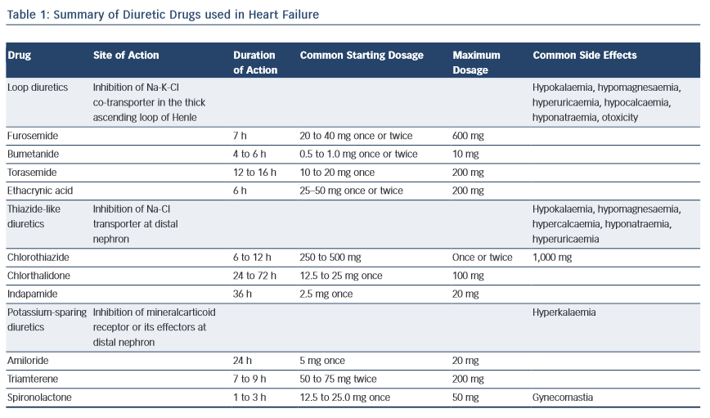
Casu G, Merella P
Table 1: Summary of Diuretic Drugs used in Heart Failure
Citation: European Cardiology Review 2015;10(1):42–7
https://doi.org/10.15420/ecr.2015.10.01.42

