Slide 1
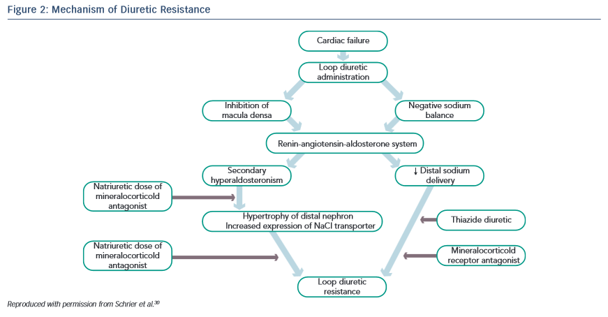
Casu G, Merella P
Mechanism of Diuretic Resistance
Citation: European Cardiology Review 2015;10(1):42–7
https://doi.org/10.15420/ecr.2015.10.01.42

