Slide 1
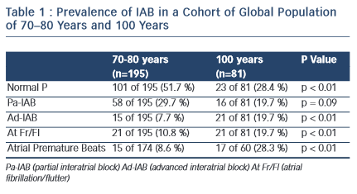
Bayés de Luna A, Massó-van Roessel A, Escobar Robledo LA
Table 1 : Prevalence of IAB in a Cohort of Global Population of 70–80 Years and 100 Years
Citation: European Cardiology Review 2015;10(1):54–9
https://doi.org/10.15420/ecr.2015.10.01.54

