Slide 1
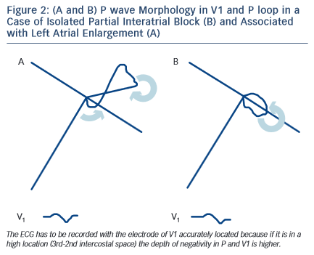
Bayés de Luna A, Massó-van Roessel A, Escobar Robledo LA
Figure 2: (A and B) P wave Morphology in V1 and P loop in a Case of Isolated Partial Interatrial Block (B) and Associated with Left Atrial Enlargement (A)
Citation: European Cardiology Review 2015;10(1):54–9
https://doi.org/10.15420/ecr.2015.10.01.54

