Slide 1
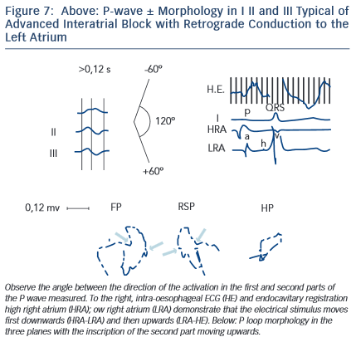
Bayés de Luna A, Massó-van Roessel A, Escobar Robledo LA
Figure 7: Above: P-wave ± Morphology in I II and III Typical of Advanced Interatrial Block with Retrograde Conduction to the Left Atrium
Citation: European Cardiology Review 2015;10(1):54–9
https://doi.org/10.15420/ecr.2015.10.01.54

