Slide 1
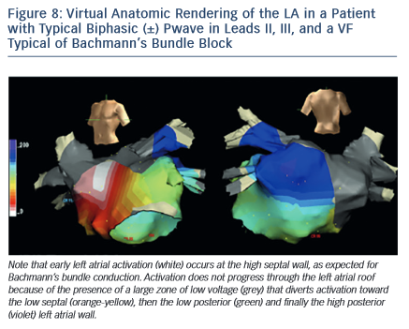
Bayés de Luna A, Massó-van Roessel A, Escobar Robledo LA
Figure 8: Virtual Anatomic Rendering of the LA in a Patient with Typical Biphasic (±) Pwave in Leads II, III, and a VF Typical of Bachmann’s Bundle Block
Citation: European Cardiology Review 2015;10(1):54–9
https://doi.org/10.15420/ecr.2015.10.01.54

