Slide 1
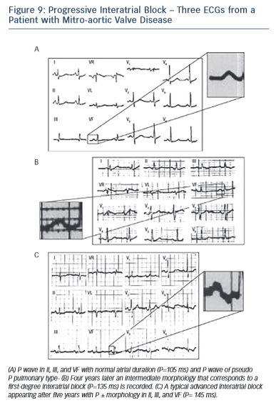
Bayés de Luna A, Massó-van Roessel A, Escobar Robledo LA
Figure 9: Progressive Interatrial Block – Three ECGs from a Patient with Mitro-aortic Valve Disease
Citation: European Cardiology Review 2015;10(1):54–9
https://doi.org/10.15420/ecr.2015.10.01.54

