Slide 1
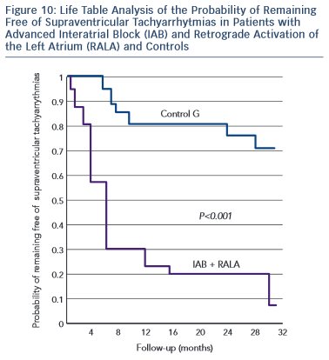
Bayés de Luna A, Massó-van Roessel A, Escobar Robledo LA
Figure 10: Life Table Analysis of the Probability of Remaining Free of Supraventricular Tachyarrhytmias in Patients with Advanced Interatrial Block (IAB) and Retrograde Activation of the Left Atrium (RALA) and Controls
Citation: European Cardiology Review 2015;10(1):54–9
https://doi.org/10.15420/ecr.2015.10.01.54

