Slide 1
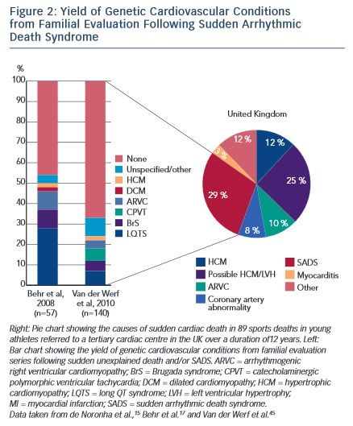
D'Silva A, Papadakis M
Yield of Genetic Cardiovascular Conditions
Citation: European Cardiology Review 2015;10(1):48–53
https://doi.org/10.15420/ecr.2015.10.01.48

