Slide 1
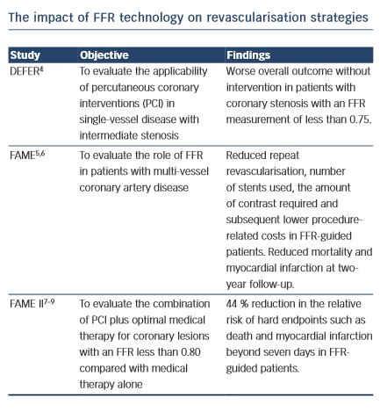
Casselman F, Van der Merwe J
The impact of FFR technology on revascularisation strategies
Citation: RadcliffeCardiology.com, July 2014

