Slide 1
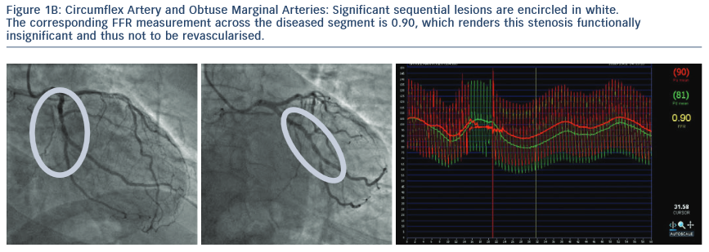
Casselman F, Van der Merwe J
Circumflex Artery and Obtuse Marginal Arteries
Citation: RadcliffeCardiology.com, July 2014

