Slide 1
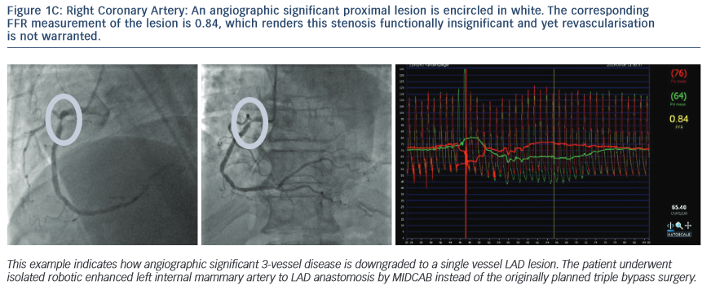
Casselman F, Van der Merwe J
Right Coronary Artery
Citation: RadcliffeCardiology.com, July 2014

