Slide 1
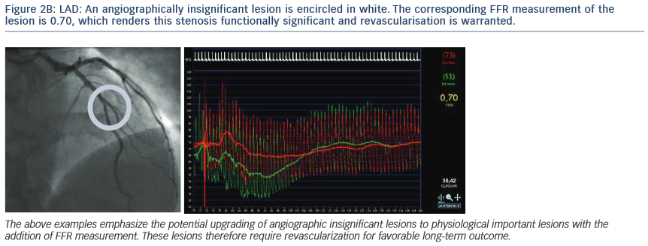
Casselman F, Van der Merwe J
The corresponding FFR measurement of the lesion is 0.70, which renders this stenosis functionally significant and revascularisation is warranted.
Citation: RadcliffeCardiology.com, July 2014

