Slide 1
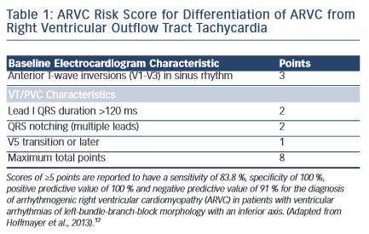
Ermakov S, Scheinman M
ARVC Risk Score for Differentiation of ARVC from Right Ventricular Outflow Tract Tachycardia
Citation: Arrhythmia & Electrophysiology Review 2015; 4(2):86–9
https://doi.org/10.15420/aer.2015.04.02.86

