Slide 1
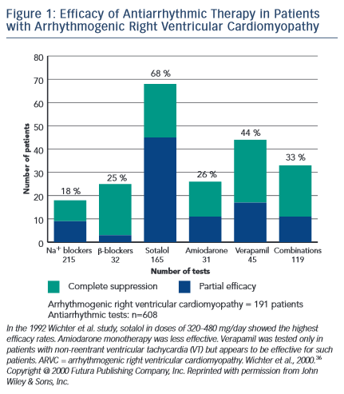
Ermakov S, Scheinman M
Efficacy of Antiarrhythmic Therapy in Patients with Arrhythmogenic Right Ventricular Cardiomyopathy
Citation: Arrhythmia & Electrophysiology Review 2015; 4(2):86–9
https://doi.org/10.15420/aer.2015.04.02.86

