Slide 1
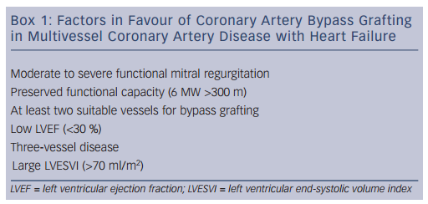
Pepper J
Managing Heart Failure Patients with Multivessel Disease – Coronary Artery Bypass Graft versus Percutaneous Coronary Intervention
Citation: Cardiac Failure Review 2015;1(2):118–22
https://doi.org/10.15420/cfr.2015.1.2.118

