Slide 1
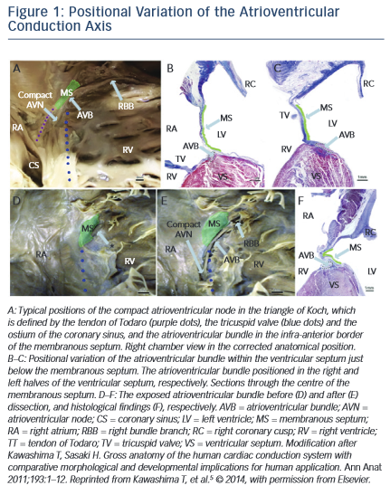
Young Lee M, Yeshwant SC, Chava S, Lustgarten DL
Positional Variation
Citation: Arrhythmia & Electrophysiology Review 2015;4(2):81–5
https://doi.org/10.15420/aer.2015.04.02.81

