Slide 1
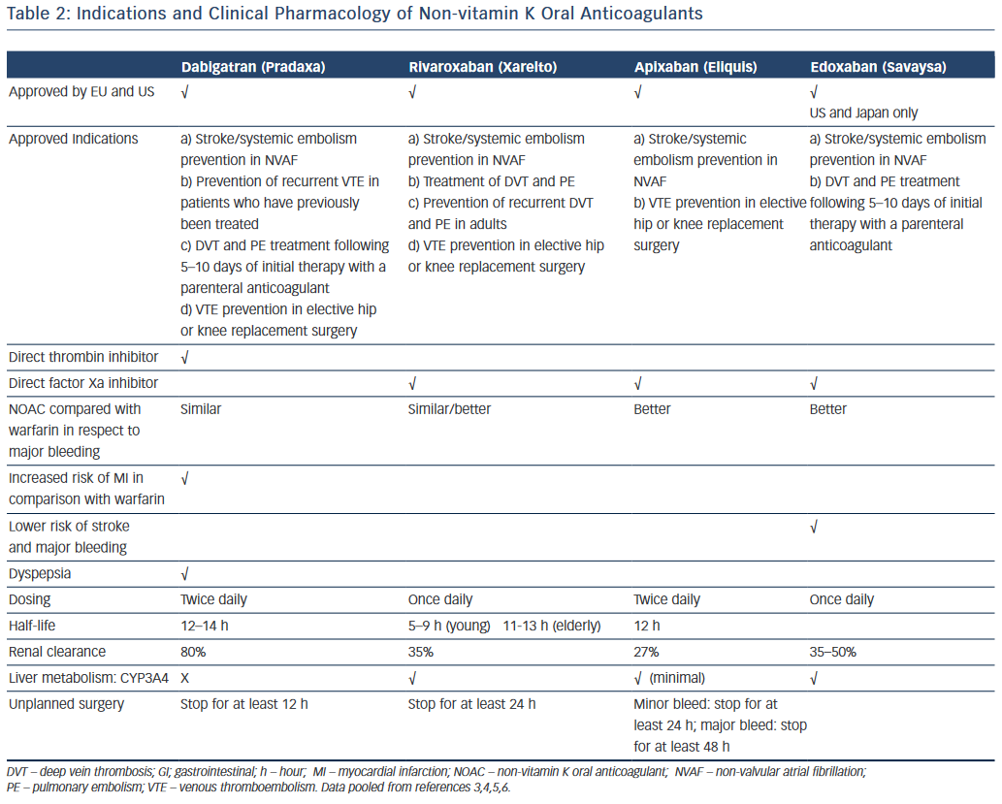
Rahmat NA, Lip GY
Indications and Clinical Pharmacology
Citation: Arrhythmia & Electrophysiology Review 2015;4(1):90–5
https://doi.org/10.15420/aer.2015.04.02.90

