Slide 1
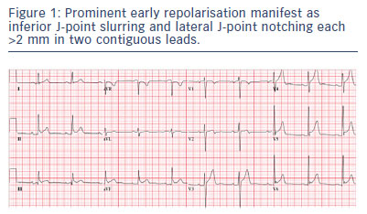
Obeyesekere MN, Krahn AD
Prominent early repolarisation manifest as inferior J-point slurring and lateral J-point notching each &gt;2 mm in two contiguous leads.
Citation: Arrhythmia & Electrophysiology Review 2015;4(2):96–9
https://doi.org/10.15420/aer.2015.04.02.96

