Slide 1
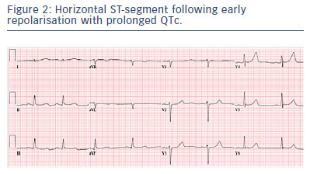
Obeyesekere MN, Krahn AD
Horizontal ST-segment following early repolarisation with prolonged Qtc.
Citation: Arrhythmia & Electrophysiology Review 2015;4(2):96–9
https://doi.org/10.15420/aer.2015.04.02.96

