Slide 1
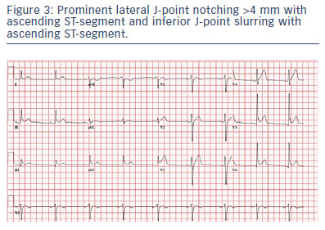
Obeyesekere MN, Krahn AD
Prominent lateral J-point notching &gt;4 mm with ascending ST-segment and inferior J-point slurring with ascending ST-segment.
Citation: Arrhythmia & Electrophysiology Review 2015;4(2):96–9
https://doi.org/10.15420/aer.2015.04.02.96

