Slide 1
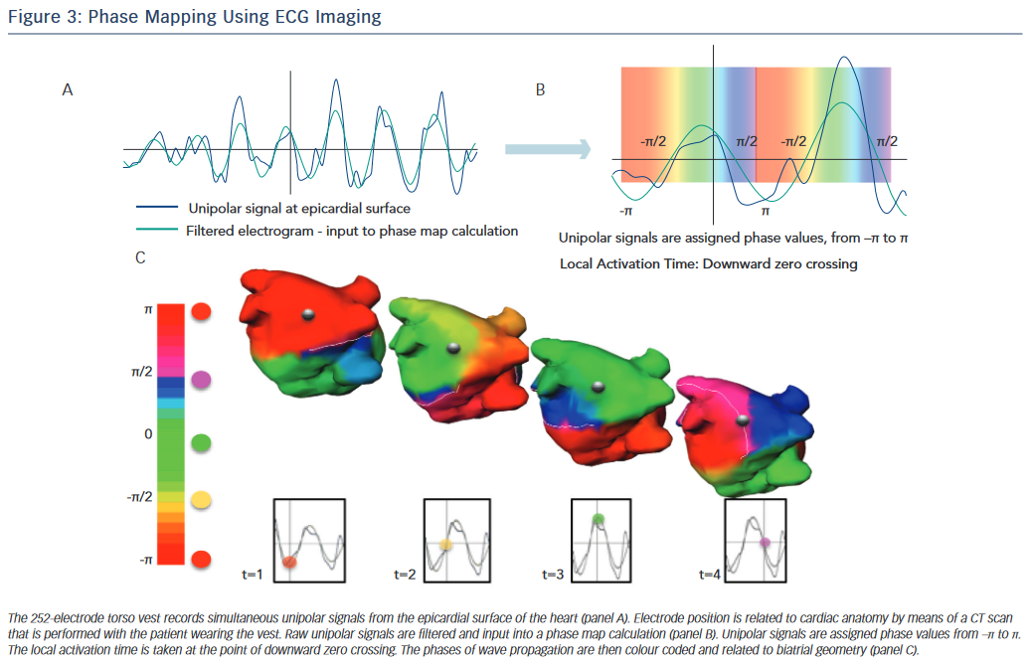
Sohal M, Choudhury R, Taghji P, Louw R, Wolf M, Fedida J, Vandekerckhove Y, Tavernier R, Duytschaever M, Knecht S
Phase Mapping Using ECG
Citation: Arrhythmia & Electrophysiology Review 2015;4(2):109–15
https://doi.org/10.15420/aer.2015.04.02.109

