Slide 1
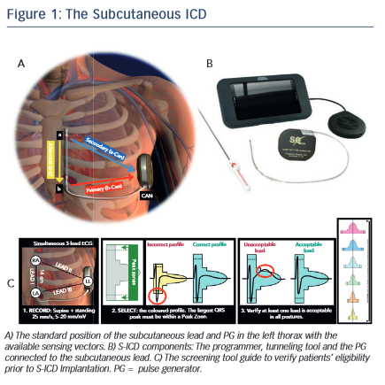
Ali H, Lupo P, Cappato R
The Subcutaneous ICD
Citation: Arrhythmia & Electrophysiology Review 2015;4(2):116–21
https://doi.org/10.15420/aer.2015.04.02.116

