Slide 1
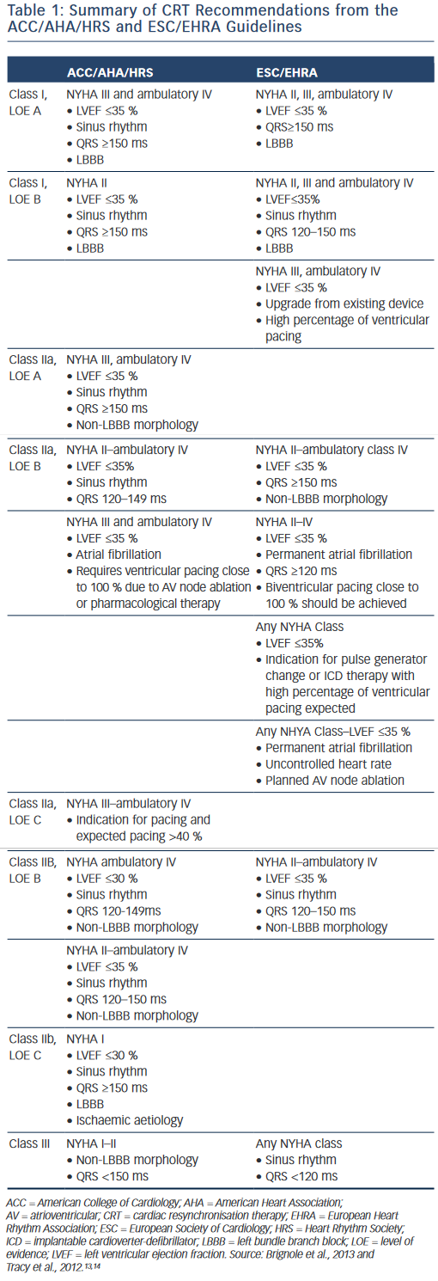
Lewis GF, Gold MR
Table 1: Summary of CRT Recommendations from the ACC/AHA/HRS and ESC/EHRA Guidelines
Citation: Arrhythmia & Electrophysiology Review 2015;4(2):122–8
https://doi.org/10.15420/aer.2015.04.02.122

