Slide 1
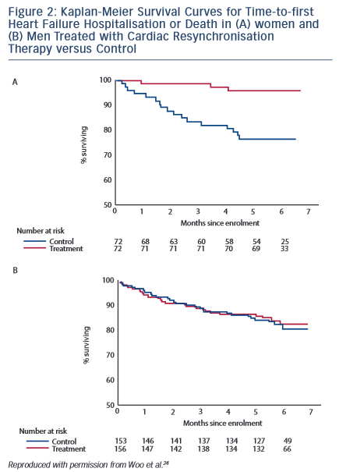
Narasimha D, Curtis AB
Kaplan-Meier Survival for Men &amp; Women
Citation: Arrhythmia & Electrophysiology Review 2015;4(2):129–35
https://doi.org/10.15420/aer.2015.04.02.129

