Slide 1
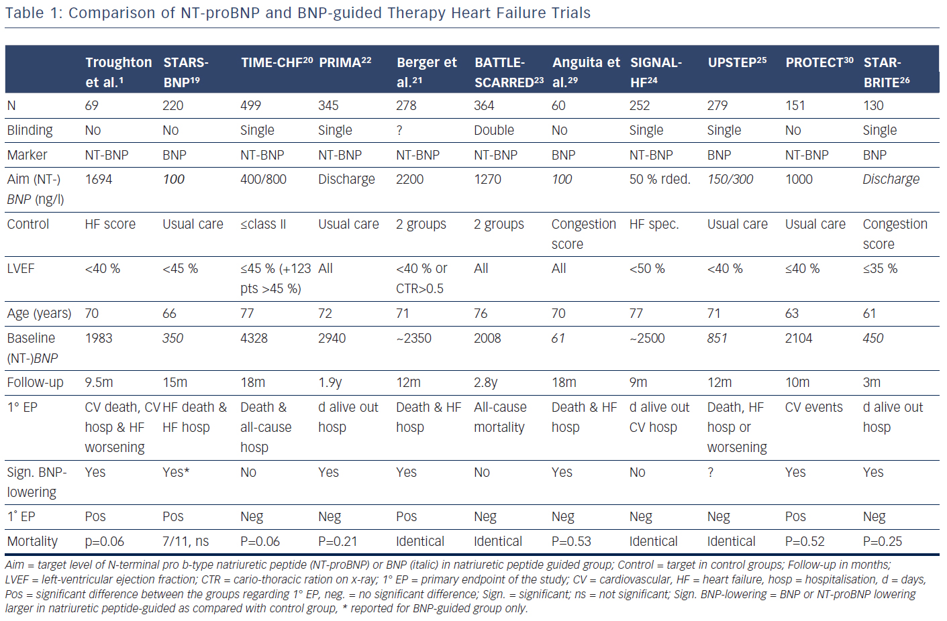
Brunner-La Rocca HP, Bektas S
Comparison of NT-proBNP and BNP-guided Therapy Heart Failure Trials
Citation: Cardiac Failure Review 2015;1(2):96–101
https://doi.org/10.15420/cfr.2015.1.2.96

