Slide 1
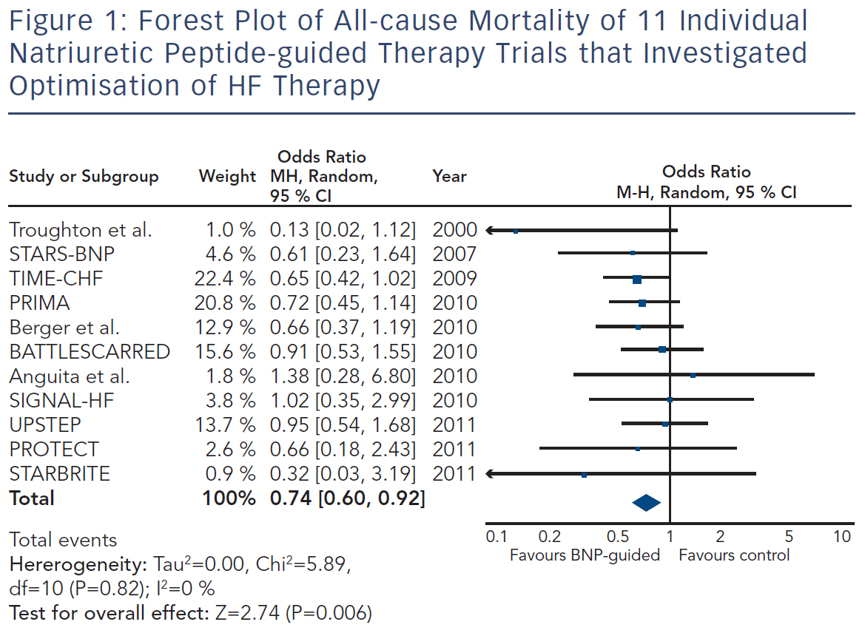
Brunner-La Rocca HP, Bektas S
Forest Plot of All-cause Mortality of 11 Individual Natriuretic Peptide-guided Therapy Trials that Investigated Optimisation of HF Therapy
Citation: Cardiac Failure Review 2015;1(2):96–101
https://doi.org/10.15420/cfr.2015.1.2.96

