Slide 1
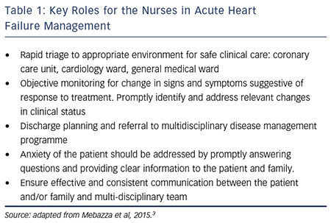
Riley J
Key Roles for the Nurses in Acute Heart Failure Management
Citation: Cardiac Failure Review 2015;1(2):123–7
https://doi.org/10.15420/cfr.2015.1.2.123

