Slide 1

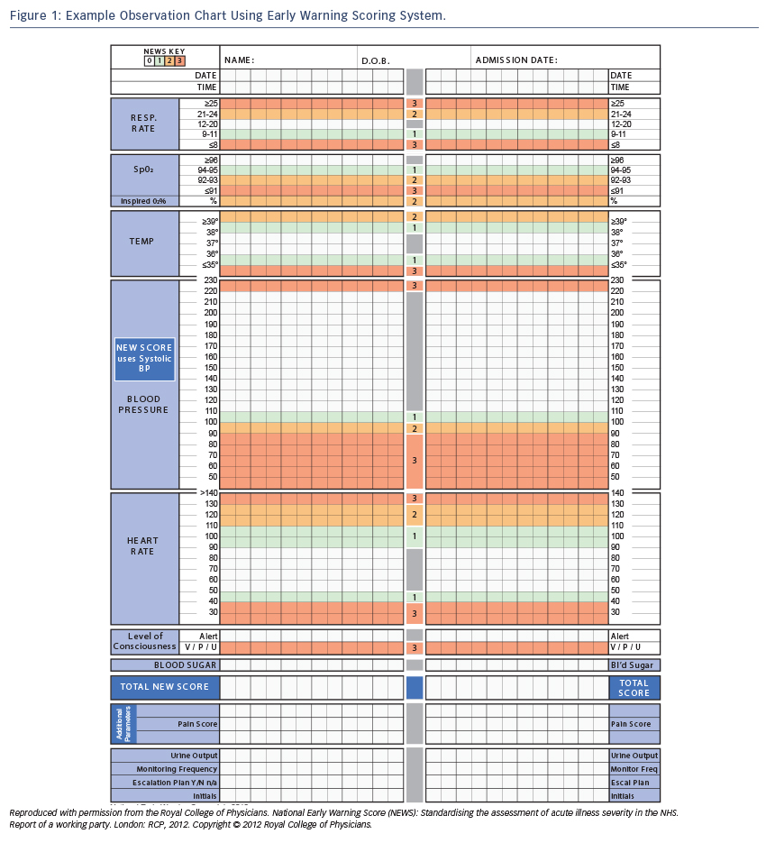
Riley J
Figure 1 Example Observation Chart
Citation: Cardiac Failure Review 2015;1(2):123–7
https://doi.org/10.15420/cfr.2015.1.2.123

