Slide 1
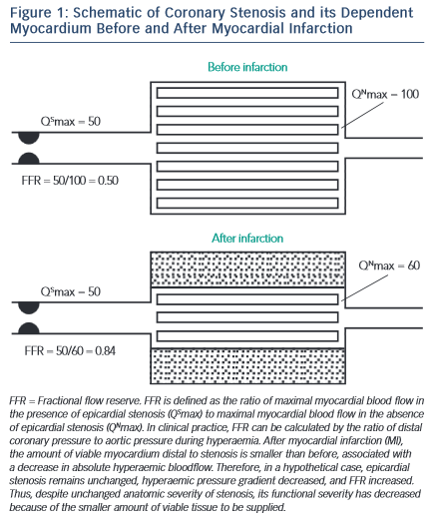
Layland J
View Image of Coronary Stenosis and its Dependent Myocardium
Citation: RadcliffeCardiology.com, September 2015

