Slide 1
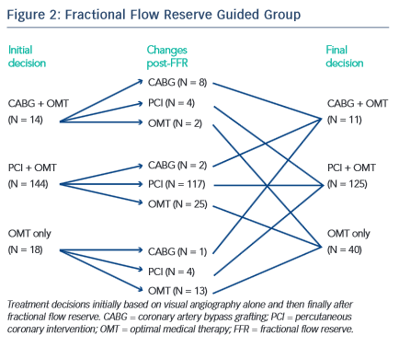
Layland J
Fractional Flow Reserve Guided Group
Citation: RadcliffeCardiology.com, September 2015

