Slide 1
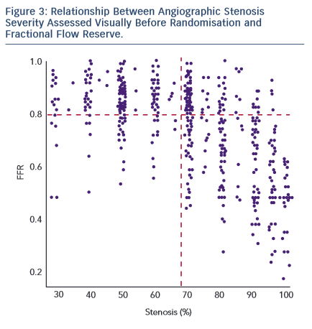
Layland J
Relationship Between Angiographic Stenosis Severity Assessed visually
Citation: RadcliffeCardiology.com, September 2015

