Slide 1
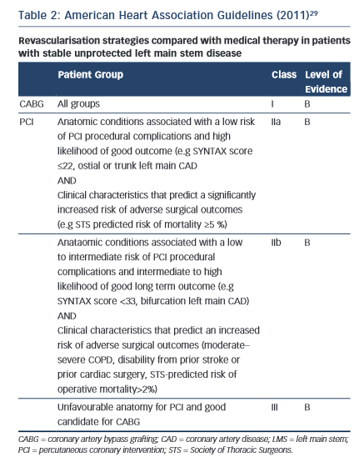
Rampat R, Hildick-Smith D
American Heart Association Guidelines – 2011
Citation: Interventional Cardiology Review 2015;10(3):132–5
https://doi.org/10.15420/icr.2015.10.03.132

