Slide 1
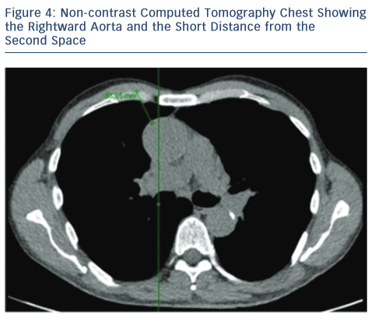
Boix-Garibo R, Uzzaman MM, Bapat V
Image showing The Rightward Aorta and The Short Distance from the Second Space
Citation: Interventional Cardiology Review 2015;10(3):144–8
https://doi.org/10.15420/icr.2015.10.03.144

