Slide 1
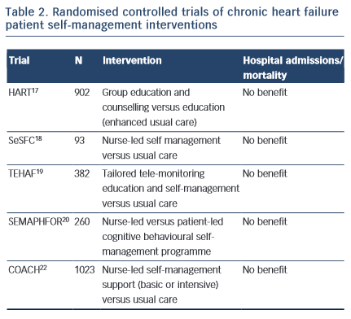
Toukhsati SR, Driscoll A, Hare DL
Summary of Chronic Heart Failure Patient Self-Management Interventions
Citation: Cardiac Failure Review 2015;1(2):128–31
https://doi.org/10.15420/cfr.2015.1.2.128

