Slide 1
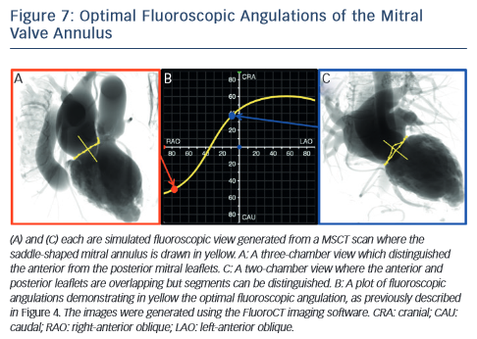
Thériault-Lauzier P, Spaziano M, Vaquerizo B, Buithieu J, Martucci G, Piazza N
Optimal Fluoroscopic Angulations of the Mitral Valve Annulus
Citation: Interventional Cardiology Review 2015;10(3):149–54
https://doi.org/10.15420/icr.2015.10.03.149

