Slide 1
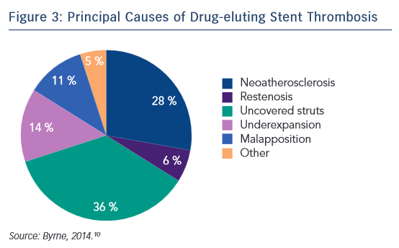
Mountfort K
Principal Causes of Drug-eluting Stent Thrombosis
Citation: Interventional Cardiology Review 2015;10(3):158–61
https://doi.org/10.15420/icr.2015.10.03.158

