Slide 1
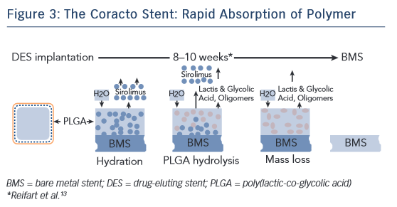
Mountfort K
The Coracto Stent : Rapid Absorption of Polymer
Citation: Interventional Cardiology Review 2015;10(3):162–6
https://doi.org/10.15420/icr.2015.10.03.162

