Slide 1
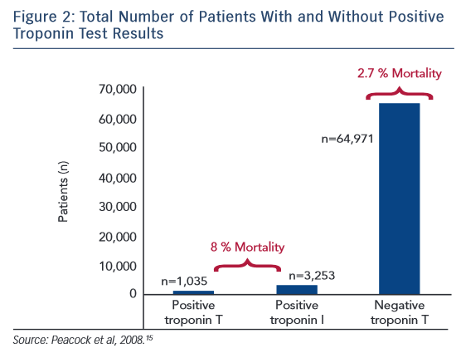
Wettersten N, Maisel AS
Positive Troponin Test Results
Citation: Cardiac Failure Review 2015;1(2):102–6
https://doi.org/10.15420/cfr.2015.1.2.102

