Slide 1
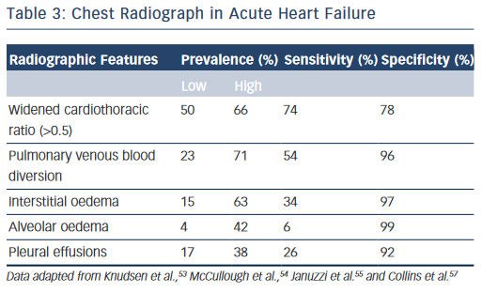
Allen CJ, Guha K, Sharma R
Chest Radiograph in Acute Heart Failure
Citation: Cardiac Failure Review 2015;1(2):69–74
https://doi.org/10.15420/cfr.2015.1.2.69

