Slide 1
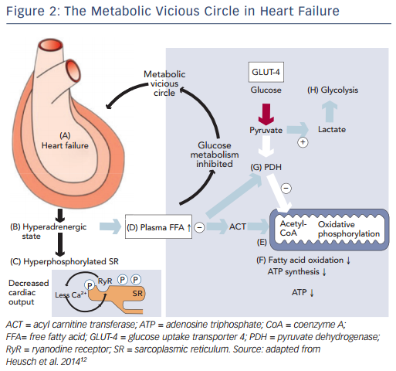
Lopatin Y
Figure 2: The Metabolic Vicious Circle in Heart Failure
Citation: Cardiac Failure Review 2015;1(2):112–7
https://doi.org/10.15420/cfr.2015.1.2.112

