Slide 1
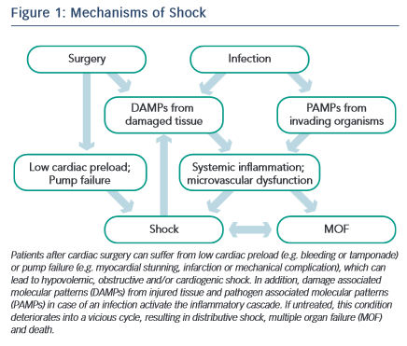
Hauffe T, Krüger B, Bettex D, Rudiger A
Mechanisms of Shock
Citation: Cardiac Failure Review 2015;1(2):75–82
https://doi.org/10.15420/cfr.2015.1.2.75

