Slide 1
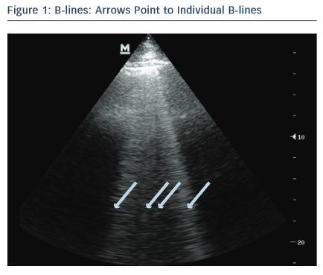
Russell FM, Rutz M, Pang PS
Point to Individual B-Lines
Citation: Cardiac Failure Review 2015;1(2):83–6
https://doi.org/10.15420/cfr.2015.1.2.83

