Slide 1

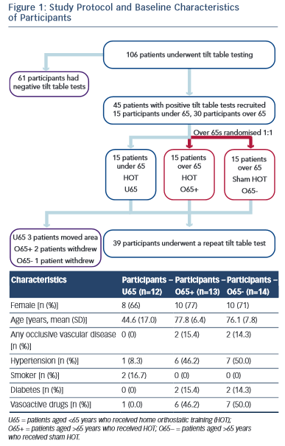
Podd S, Hunt J, Sulke N
Study Protocol and Baseline Characteristics
Citation: European Cardiology Review 2015;10(2):123–7
https://doi.org/10.15420/ecr.2015.10.2.1

