Slide 1
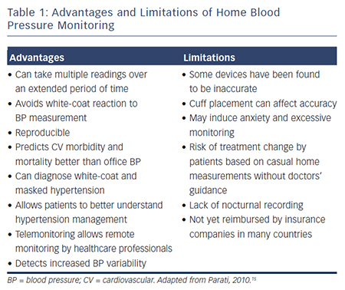
George J, MacDonald TM
Table 1: Advantages and Limitations of Home Blood Pressure Monitoring. Discover the Disadvantages of Digital Blood Pressure Monitor as well as Advantages and Disadvantages of Blood Pressure Test.
Citation: European Cardiology Review 2015;10(2):95–101
https://doi.org/10.15420/ecr.2015.10.2.95

