Slide 1
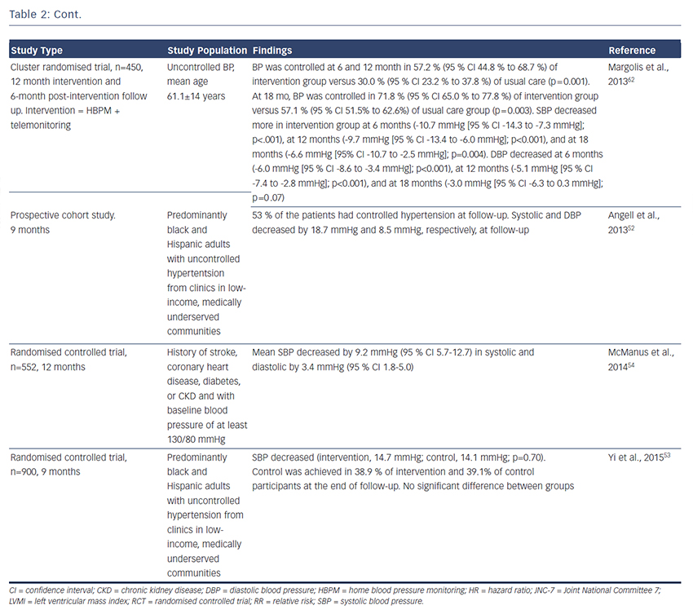
George J, MacDonald TM
Home Blood Pressure Monitoring
Citation: European Cardiology Review 2015;10(2):95–101
https://doi.org/10.15420/ecr.2015.10.2.95

