Slide 1
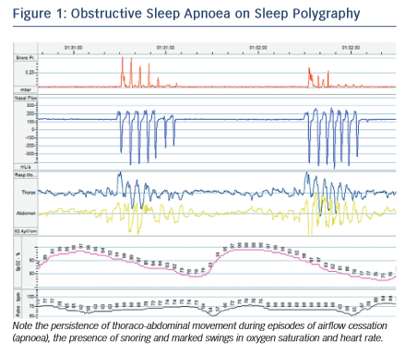
Pearse SG, Cowie MR, Sharma R, Vazir A
Obstructive Sleep Apnoea on Sleep Polygraphy
Citation: European Cardiology Review 2015;10(2):89–94
https://doi.org/10.15420/ecr.2015.10.2.89

