Slide 1
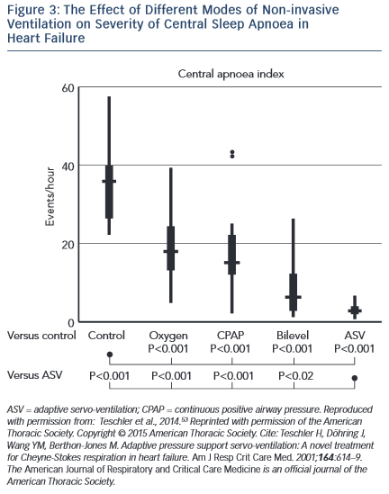
Pearse SG, Cowie MR, Sharma R, Vazir A
The Effect of Different Modes of Non-invasive&lt;br /&gt;&#10;Ventilation on Severity of Central Sleep Apnoea in&lt;br /&gt;&#10;Heart Failure
Citation: European Cardiology Review 2015;10(2):89–94
https://doi.org/10.15420/ecr.2015.10.2.89

