Slide 1
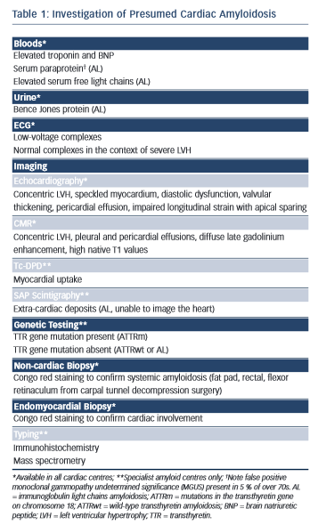
Dungu JN
Table 1: Investigation of Presumed Cardiac Amyloidosis
Citation: European Cardiology Review 2015;10(2):113–7
https://doi.org/10.15420/ecr.2015.10.2.113

