Slide 1
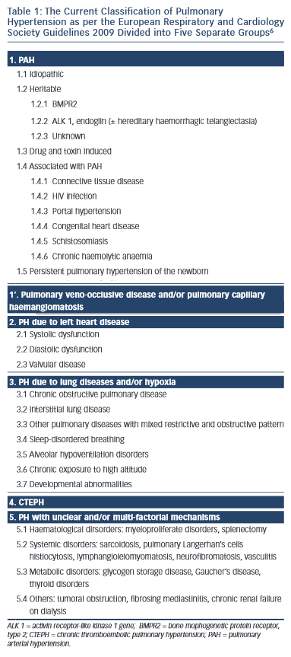
Madden BP
The Current Classification of Pulmonary Hypertension as per the European Respiratory and Cardiology Society Guidelines 2009 Divided into Five Separate Groups
Citation: European Cardiology Review 2015;10(2):102–7
https://doi.org/10.15420/ecr.2015.10.2.102

